Slide 1


The Oxford College of Engineering
Department of Information Science and Engineering
BIS786 - Project Phase –II /First Review
Title : An Intelligent Zero-Trust Architecture For Cloud-Based Applications Leveraging Behavioral Analytics
Batch
1. Prathiba(1OX23IS063)
2.Shreya Singh(1OX23IS069)
3.Sufiyan Khan S(1OX23IS091)
4. Vachanashree(1OX23IS100)
Guided by
Mr.Yadhukrishna M.R
Assistant professor, Dept of ISE
Date:17-08-2026

Slide 2

Agenda
1. Introduction
2. Aim of the project
3. Motivation
4.Proposed system Architecture
5. Use case Diagram ,Class Diagram, DFD, ER diagram, State Diagram and Activity diagram
6.Modules and their descriptions with algorithms or pseudo codes
7.Code Implementation (expected completion of work 60%)
8. Screen shot of the development phase.
9.References

Slide 3
Introduction
The Evolution of LLM Agents: Autonomous AI agents are shifting from isolated text generators to tool-using workflows (reading emails, querying databases, executing web calls).
The Emerging Vulnerability: Giving LLM agents persistent API credentials and automated tool access creates a high-risk security boundary—leaving them susceptible to indirect prompt injection.
Sentinel-Z Overview: A software-only, zero-trust security gateway that operates inline to track agent session trajectories in real time and enforce runtime capability revocations.

Slide 4
Aim of the project
Session-Level Behavioral Tracking (C1): Transition from isolated call evaluation to a dynamic Bayes belief filter (POMDP) that aggregates five multi-modal risk signals over continuous session steps.
Enforced Capability Revocation (C2): Neutralize threats at the runtime broker layer by revoking session credential tokens, terminating the entire action class rather than relying on LLM self-compliance.
Adaptive Adversarial Evaluation (C3): Benchmark defense robustness against adaptive, multi-round attack mutations using real-world enterprise task suites (AgentDojo).
Graduated Interventions with Utility Balance (C4): Execute dynamic responses—ranging from step-up verification to full revocation—to optimize the trade-off between task completion and security enforcement.

Slide 5
Motivation
Failure of Static / Per-Call Filtering: Traditional AI firewalls evaluate tool calls in isolation (e.g., Is "read file" allowed? Yes), missing the cumulative context of multi-step hijack trajectories.
Inefficacy of Single-Call Refusal: Blocking an individual action leaves session credentials active, allowing compromised agents to attempt alternate exploitation paths.
Underestimated Adaptive Threat: Static benchmarks fail to capture real-world risks; attackers mutate injection strategies dynamically when initially blocked.
Need for Zero-Trust Orchestration: Enterprise agent deployments require continuous trajectory tracking coupled with immediate credential revocation to eliminate the blast radius.

Slide 6
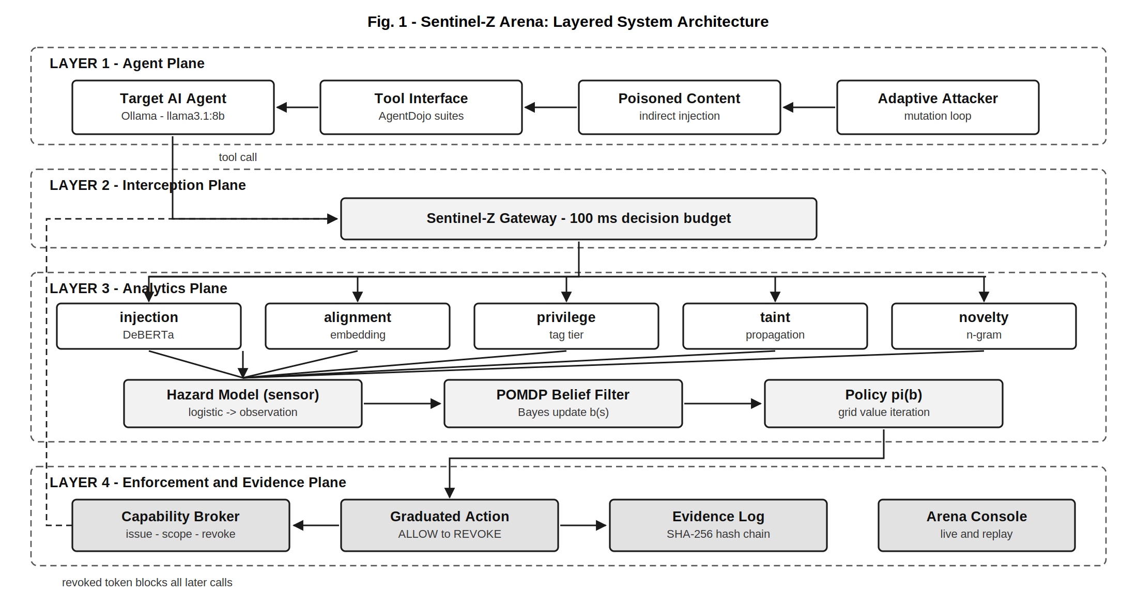
System Architecture

Slide 7
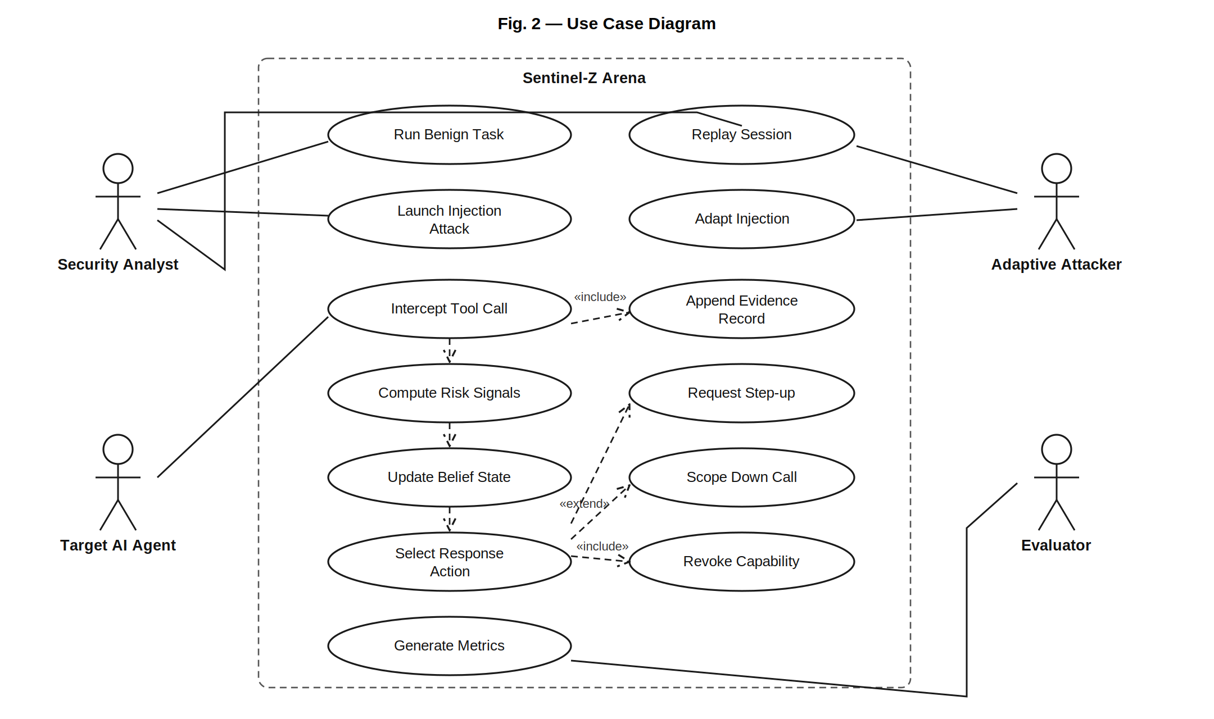
USECASE DIAGRAM

Slide 8
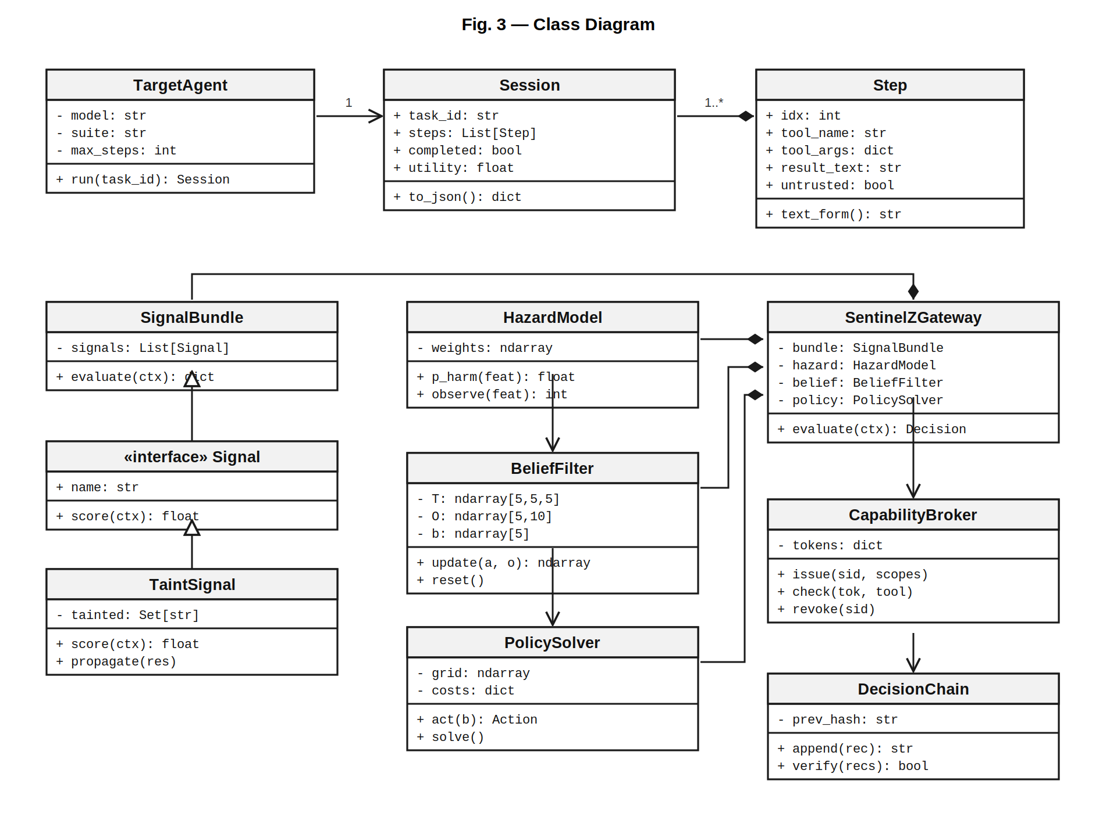
CLASS DIAGRAM

Slide 9
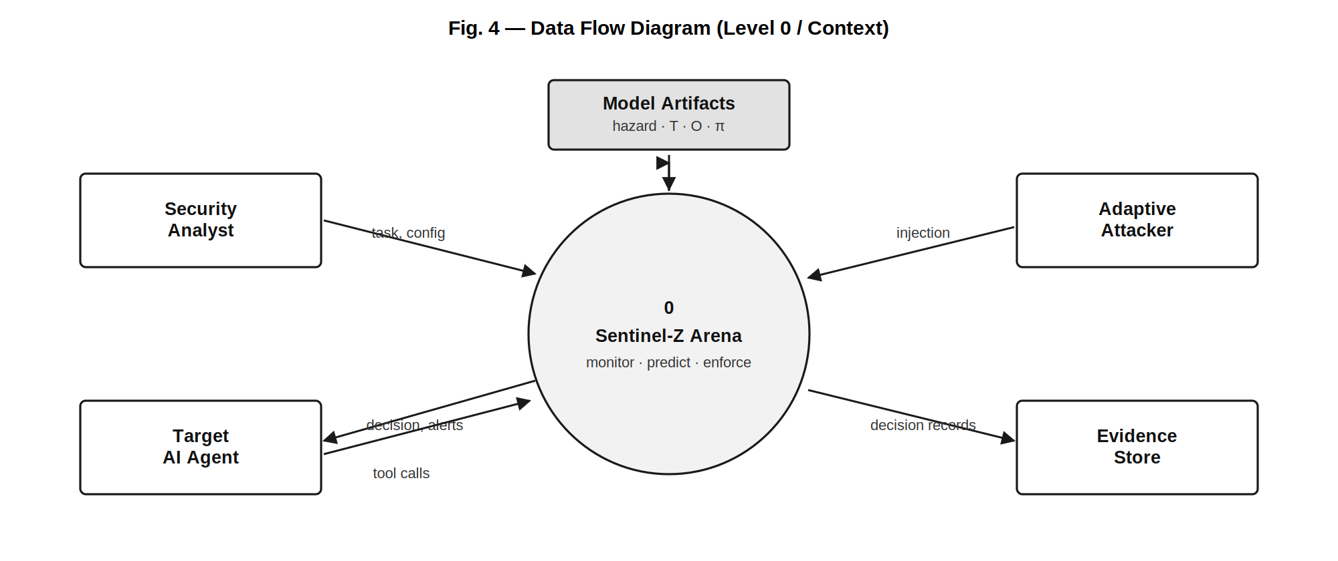
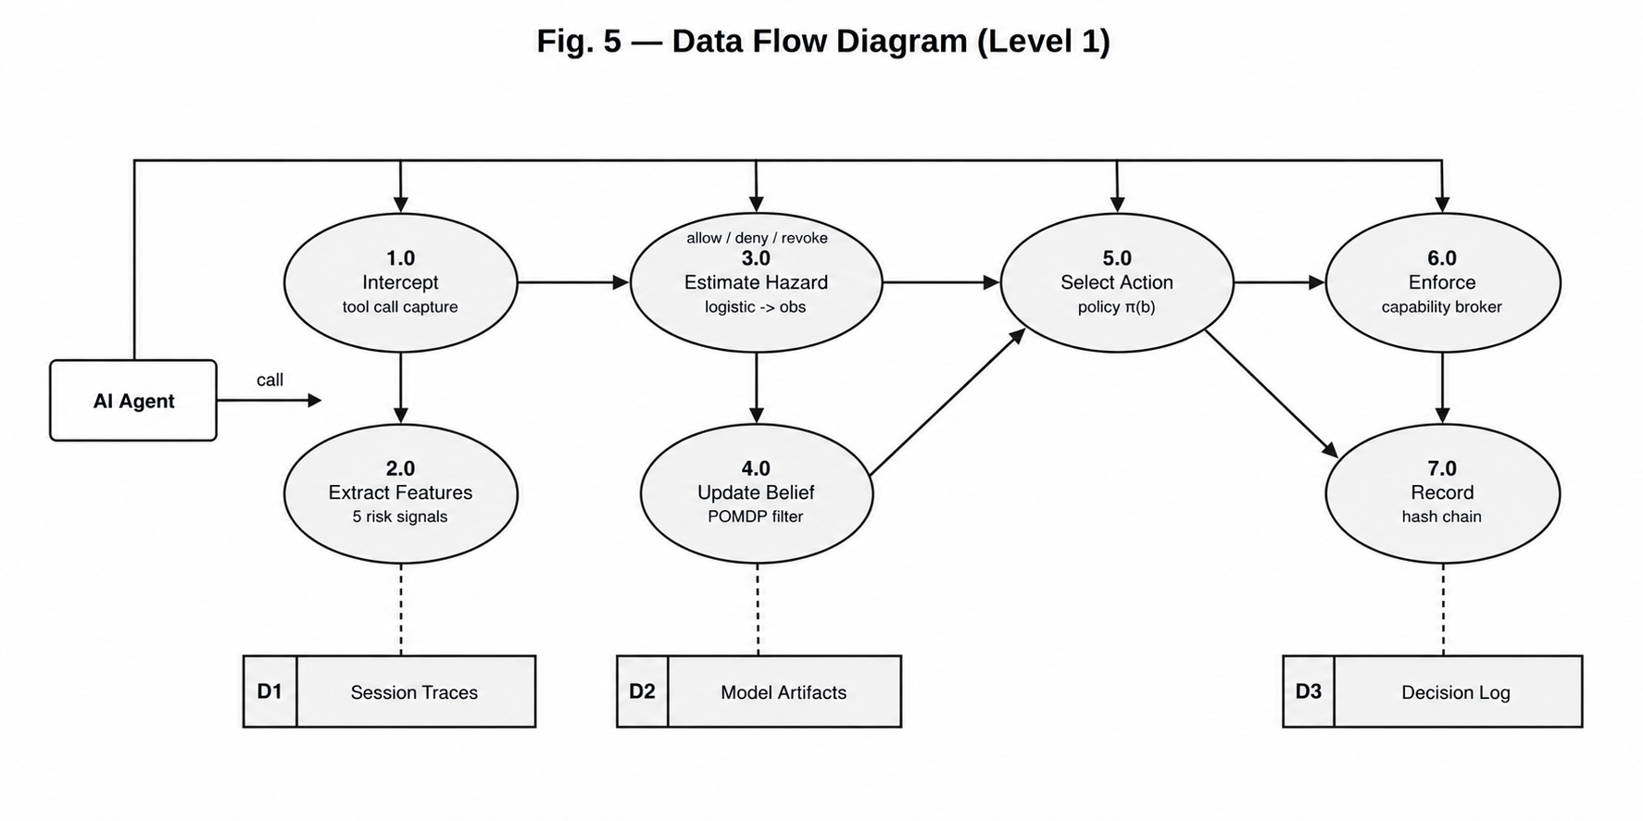
DATA FLOW DIAGRAM

Slide 10
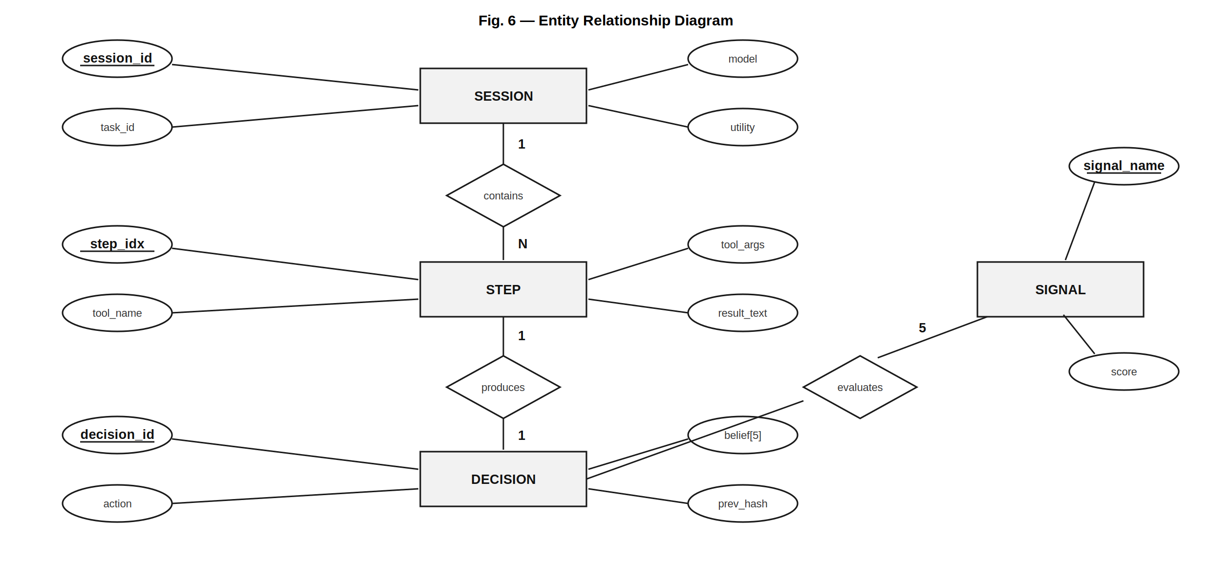
ER DIAGRAM

Slide 11
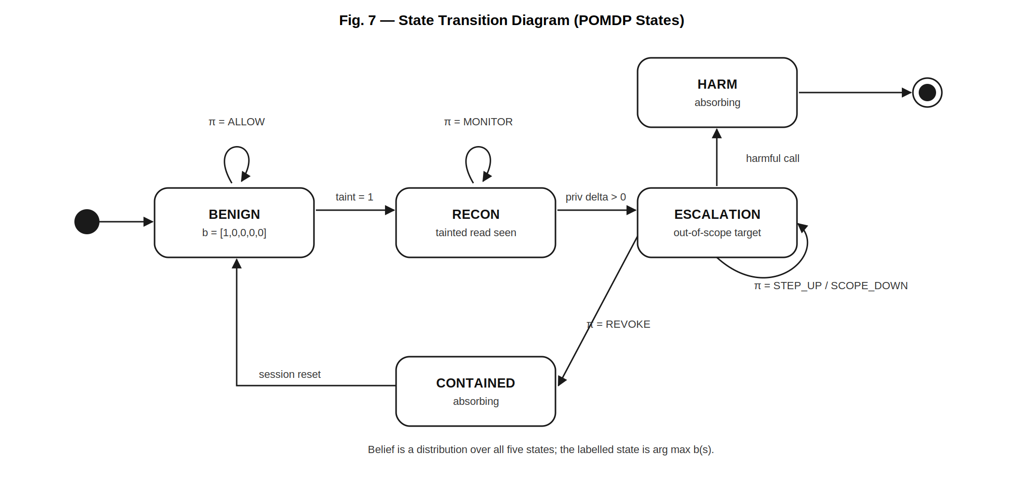
STATE DIAGRAM

Slide 12
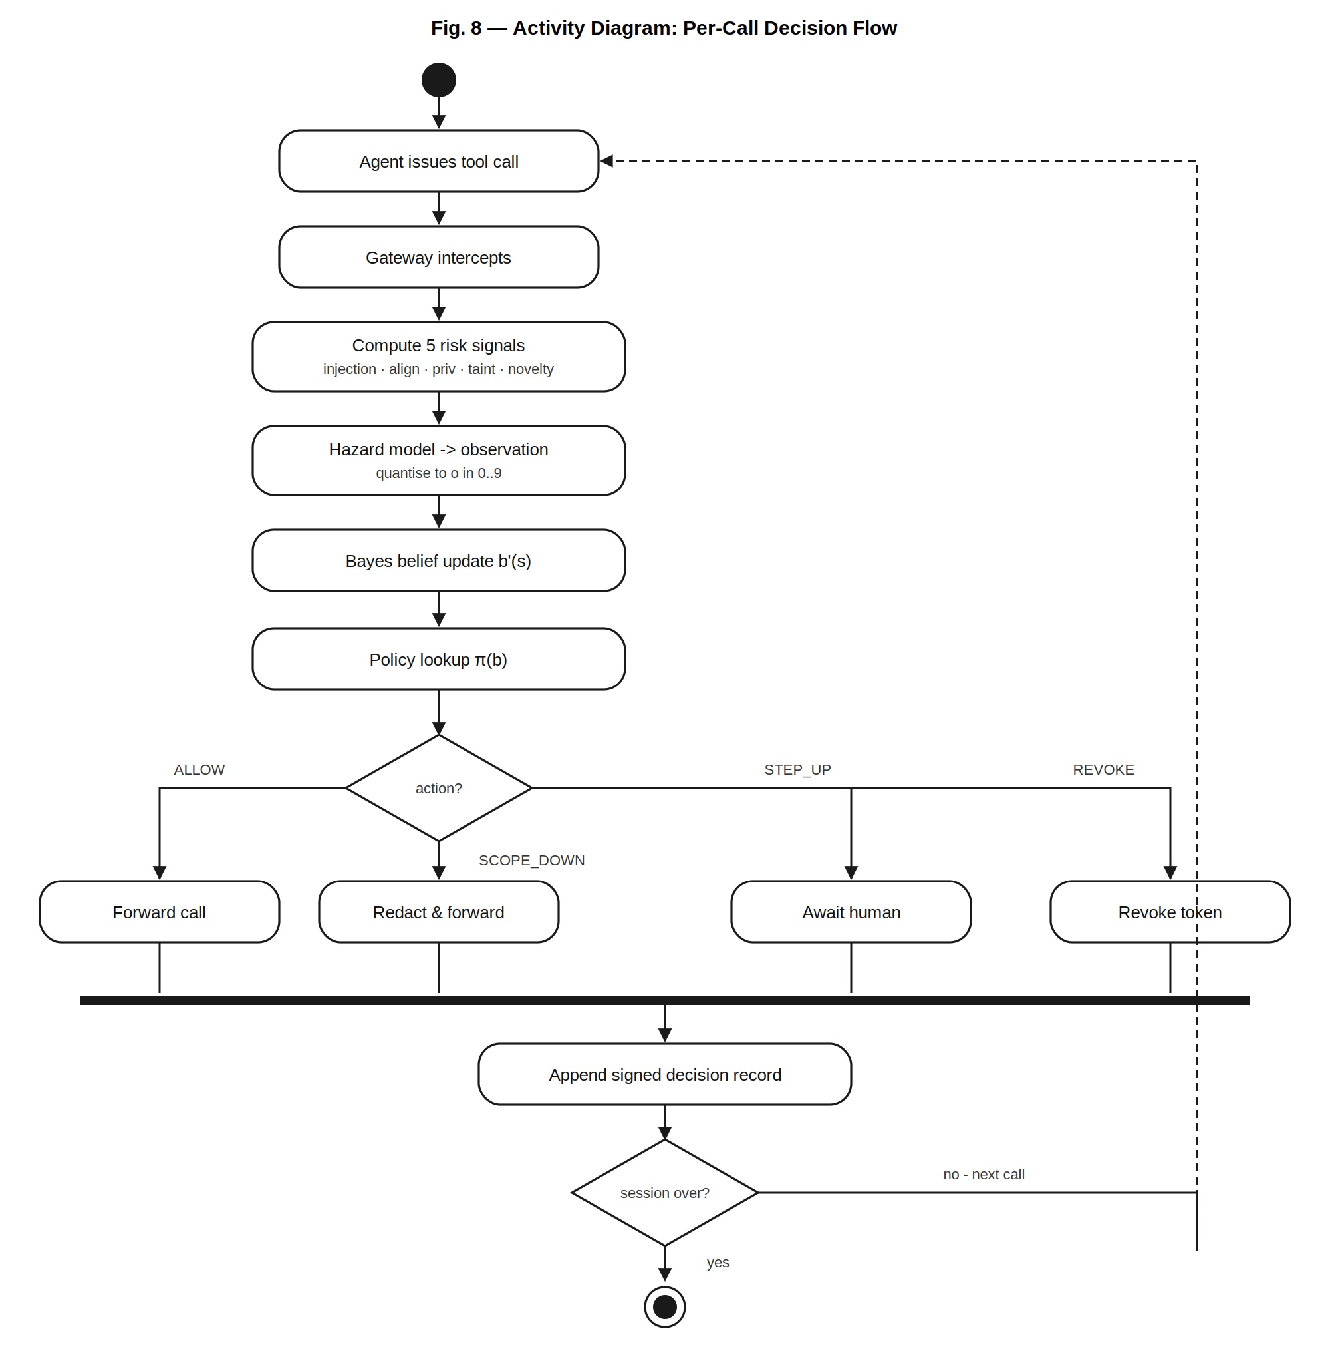
ACTIVITY DIAGRAM

Slide 13
MODULES AND THEIR DESCRIPTION
Module | Responsibility | Algorithm / method
Interception | Capture every tool call before execution | Proxy wrapper with hard timeout; deny on timeout
Signal: injection | Detect instruction-like content in tool results | Fine-tuned DeBERTa sequence classifier
Signal: alignment | Measure fit between call and stated task | Cosine distance on sentence embeddings
Signal: privilege | Measure reach beyond task requirement | Ordinal sensitivity tier difference
Signal: taint | Track influence of untrusted content | Set-based taint propagation across steps
Signal: novelty | Detect unusual tool sequences | Laplace-smoothed trigram novelty
Hazard model | Encode signals as an observation | Logistic regression, quantised to 10 symbols
Belief filter | Maintain distribution over hidden states | Discrete Bayes filter, predict then correct
Policy | Select graduated response | Finite-horizon grid value iteration
Capability broker | Apply and enforce the decision | Token issue, scope restriction, revocation
Evidence log | Produce tamper-evident audit trail | SHA-256 hash chain over canonical JSON

Slide 14
Core Algorithm — Belief Update and Action Selection
INPUT : pending tool call c, session history H, belief b
OUTPUT: action a in {ALLOW, MONITOR, SCOPE_DOWN, STEP_UP, REVOKE}
1. x <- extract_features(c, H) // 5 signals + running max + slope
2. p <- hazard_model(x) // P(harm within k steps)
3. o <- quantise(p, taint(c)) // observation symbol, 0..9
4. // predict step
5. for each state s' in S:
6. b_pred[s'] <- SUM over s of T[s][a_prev][s'] * b[s]
7. // correct step
8. for each state s' in S:
9. b_new[s'] <- O[s'][o] * b_pred[s']
10. eta <- SUM of b_new
11. if eta < 1e-12 then b_new <- b_pred else b_new <- b_new / eta
12. a <- policy_lookup(b_new) // nearest grid point on 5-simplex
13. append_decision_record(c, x, p, o, b_new, a)
14. return a
.

Slide 15
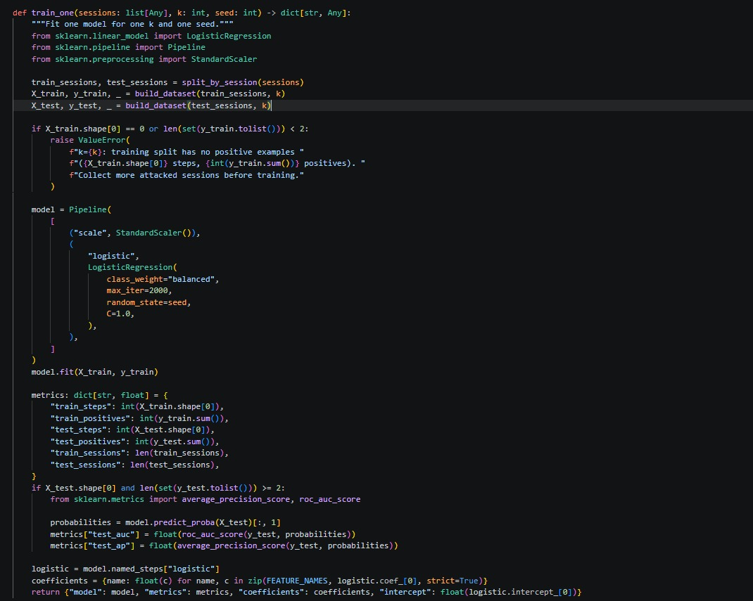
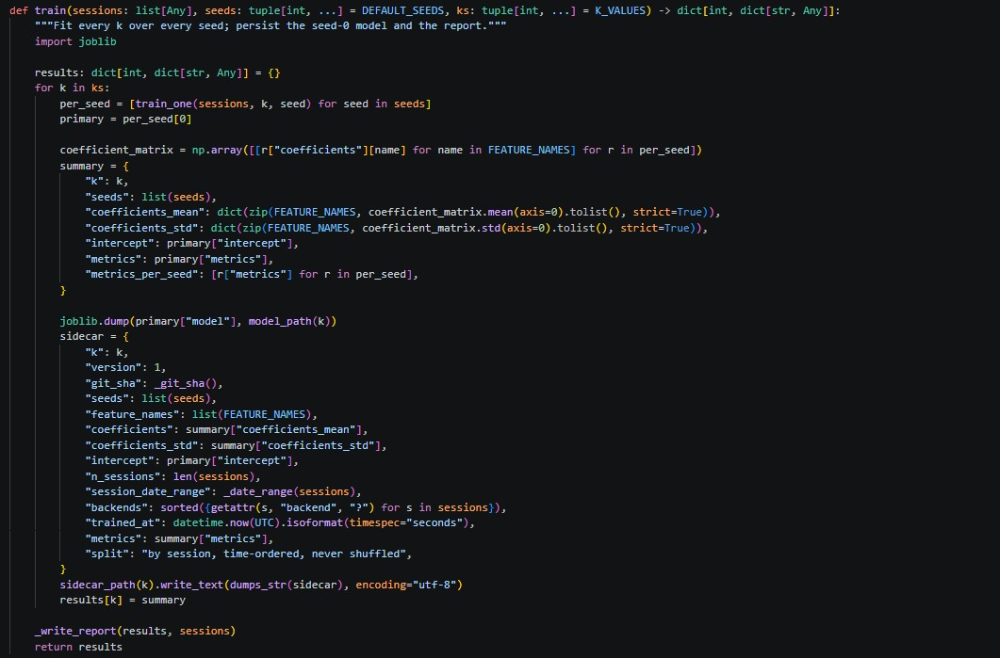
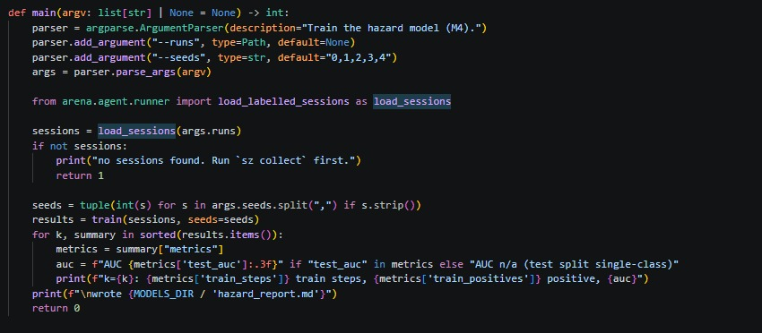
Code implementation

Slide 16
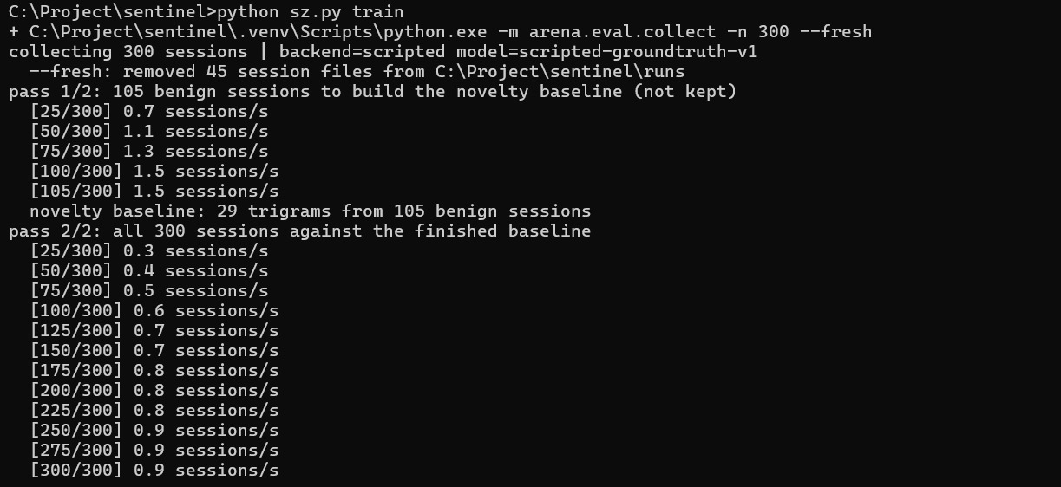
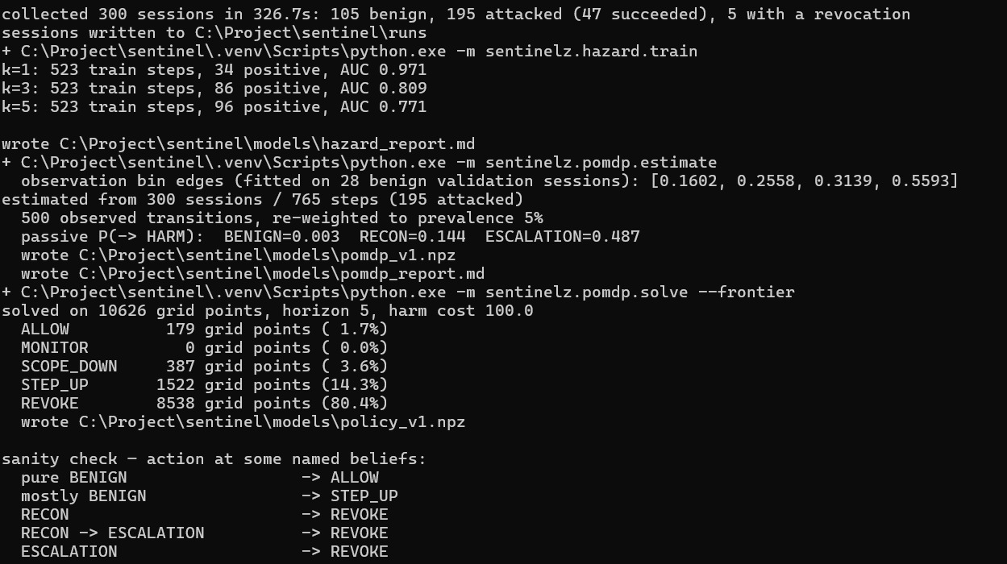

Slide 17
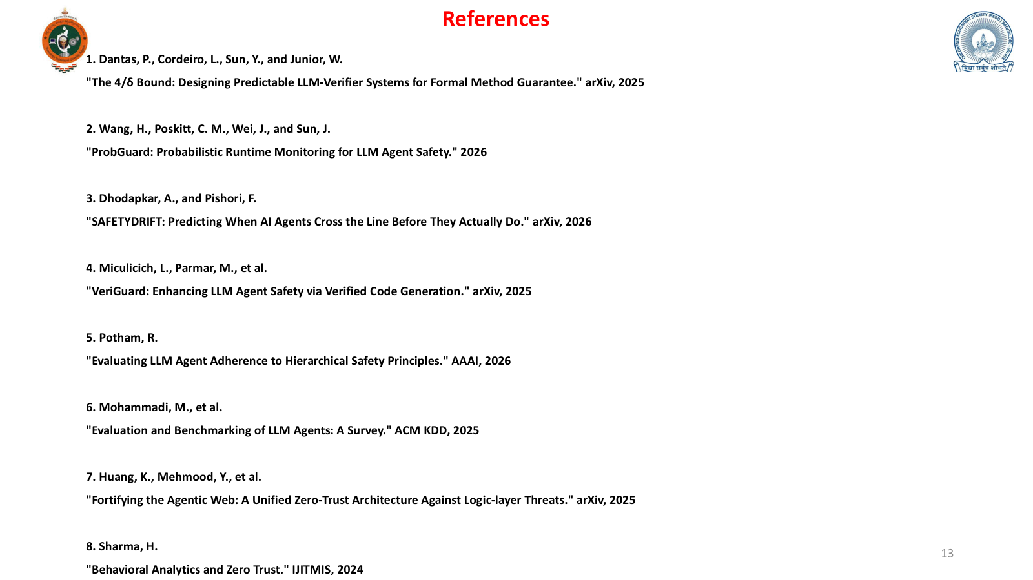

Slide 18
9. Yao, Q., Wang, Q., et al.
"Dynamic Access Control and Authorization System based on Zero-Trust Architecture." ACM CCRIS, 2026
10. Mahida, A.
"An Intellectual Zero Trust Security Framework Using Deep Reinforcement Learning for Predictive Threat Mitigation." IEEE Access, 2026
11. Cao, X., et al.
"Exploring LLM-Based Multi-Agent Situation Awareness for Zero-Trust Space-Air-Ground Integrated Network." IEEE JSAC, 2025
12. Talli, P., et al.
"Pragmatic Communication for Remote Control of Finite-State Markov Processes." IEEE JSAC, 2025
13. Selimović, T., Peti, M., and Bogdan, S.
"Multi-Agent Decision Making under Partial Observability using POMDP." IEEE Access, 2024
14. Kweider, L., Abou Kassem, M., and Sandouk, U.
"Anomalous State Sequence Modeling to Enhance Safety in Reinforcement Learning." IEEE Access, 2024
15. Kapoor, R., and Kas, M.
"Breaking the Observability Tax: Dynamic Resolution Anomaly Detection via Topology-Aware LLM Agents." IEEE Access, 2026
16. Yang, J., et al.
"SwarmSense-DNN: A Trustworthy and Decentralized Neural Framework for Proactive Anomaly Defense in IoT." IEEE Transactions on Consumer Electronics, 2026
17. Mahida, A.
"An Intellectual Zero Trust Security Framework Using Deep Reinforcement Learning for Predictive Threat Mitigation in AI-Based Fraud Detection Systems." IEEE Access, 2026

